Slide 1

AAD PRoject
Team AP

Slide 2
Table of Contents
Brief Overview of the project idea
Work Flow
Achievements
Future Goals
Roadmap towards achieving future goals

Slide 3
Overview
As discussed earlier, we intend to write a novel that pays homage to the arduous process of algorithm design in a manner that is relatable and engaging for people of all ages, especially those belonging to the younger generation.
The novel is set in a fictionalized universe where algorithms compete on the basis of factors such as time optimization, space optimization and randomness optimization in order to determine the best.
Each algorithm is mentored by their creator to improve its design so it can solve all kinds of problems in the most efficient manner possible.
The underlying message is that every algorithm can always be made better, and each victor is just the best known algorithm.
We focus on the nth Fibonacci number, Shortest Path and Sorting Problems in this novel.

Slide 4
Work Flow
The three problems have been divided into three different section of the novel which will be written by the three of us individually. An epilogue and a prologue will tie the three components of the story together.
Sorting: Bubble Sort, Merge Sort, Heap Sort and Quick Sort - Meghna
Shortest Path: Dijkstra, Bellman-Ford, Floyd-Warshall, Top Sort – Dhruvee
Nth Fibonacci Number: Iterative, Dynamic Programming, Fast Doubling, Binet’s Formula – Arushi
Epilogue and Prologue – Group effort
Estimated length of novel: 50 – 100 pages

Slide 5




Achievements
Research
Division of Work
Discussions
Building a draft

Slide 6
Future Goals
Implementing the research to use it in the finished product
Writing the individual phases and bringing them together.
Proof Reading and checking for improvements.
Adding the code to implement the algorithms, including pictures if time permits.

Slide 7
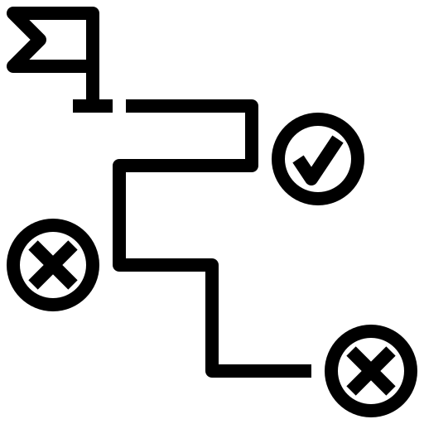
Roadmap
Estimated Time of Completion: Mid-November
Writing (3 – 4 weeks)
Finalize Idea (10 days)
Research (10 days)

Slide 8


